Slide 1
Welcome to Section!!!
Week One

Slide 2
Introductions

Slide 3



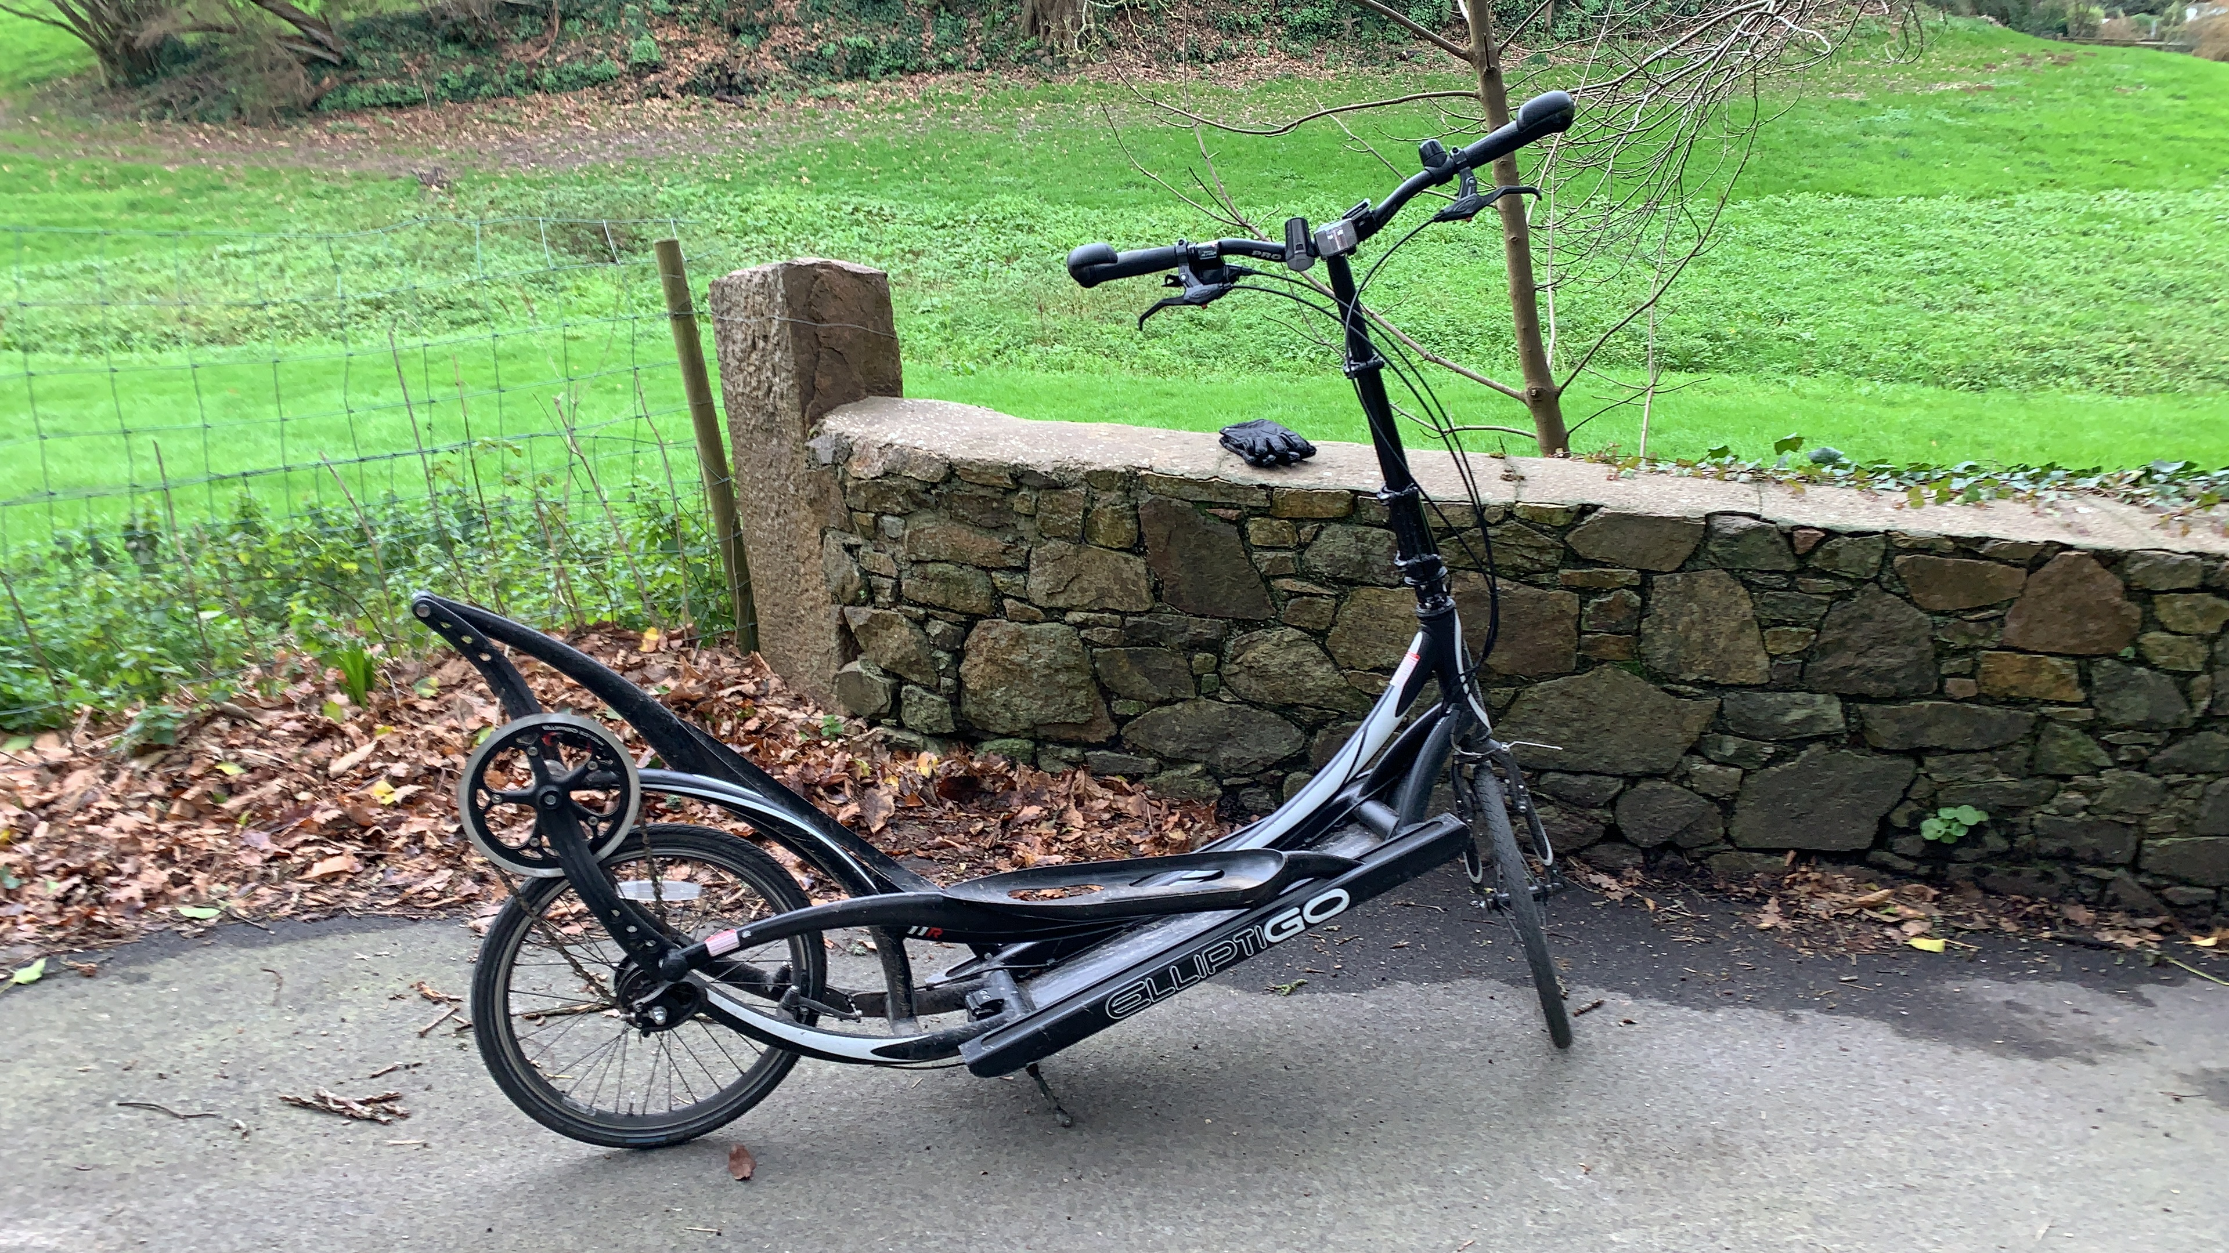


A Little About Francois
My name is François. I’ll be your Section Leader for Code in Place
I am also a CF for AI classes XCS224N and XCS221 at Stanford.
In my free time I like to ride my Elliptigo.
I enjoy spending time with my kids and teaching them coding.
Artificial Intelligence: Principles and Techniques
XCS221
Natural Language Processing with Deep Learning
XCS224N

Slide 4

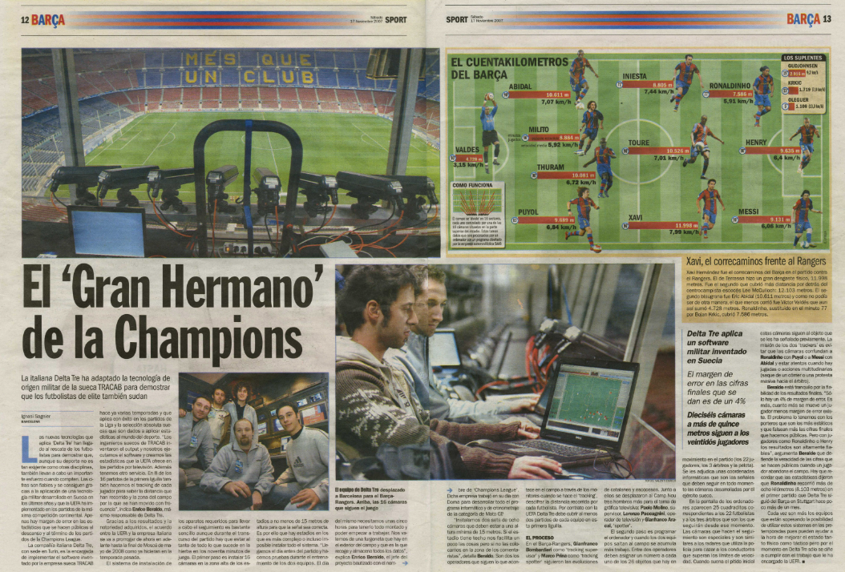


A Little About Gian
My name is Gian. I’ll be your tutor, and everyone here will be your section-mates!
I am working in Data Science, leading the Business Intelligence department for a consultancy based in London.
In my free time I like to cycle, exploring new places/ things and…coding, of course!
I have a beautiful cat called Martino, who likes to quality control my work!
YOUR BEAUTIFUL PICTURE GOES HERE <3

Slide 5
What About You All?
🔨
🧊
Go ahead and share:
Your name
What’s one awesome thing you want to program Karel to do?
Why are you excited about learning Python and what are your goals?

Slide 6
Why are we here?
Live Section != lecture
This is your time. We are here to help answer your questions about section material.
Finishing problem isn’t important.
Building a community of learners.

Slide 7
Lecture Review

Slide 8
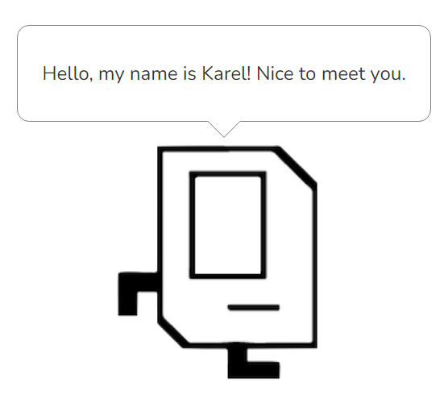
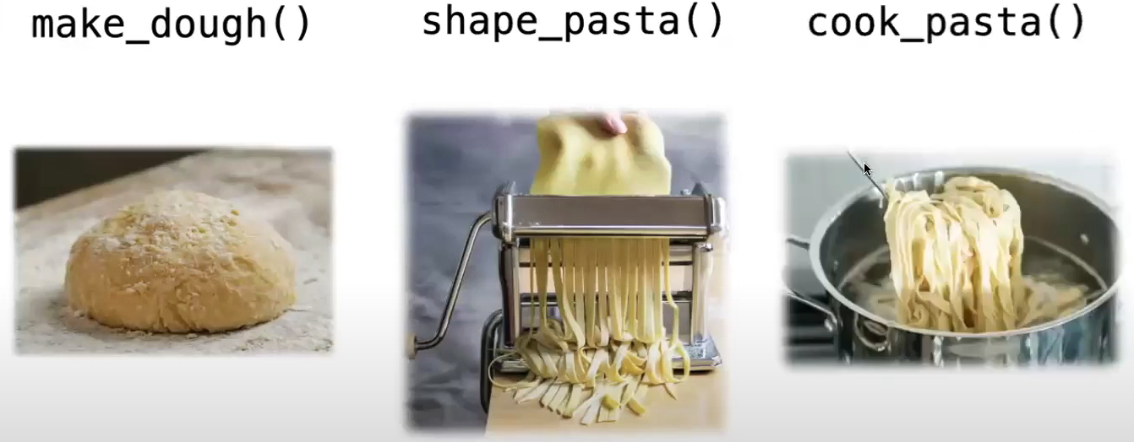
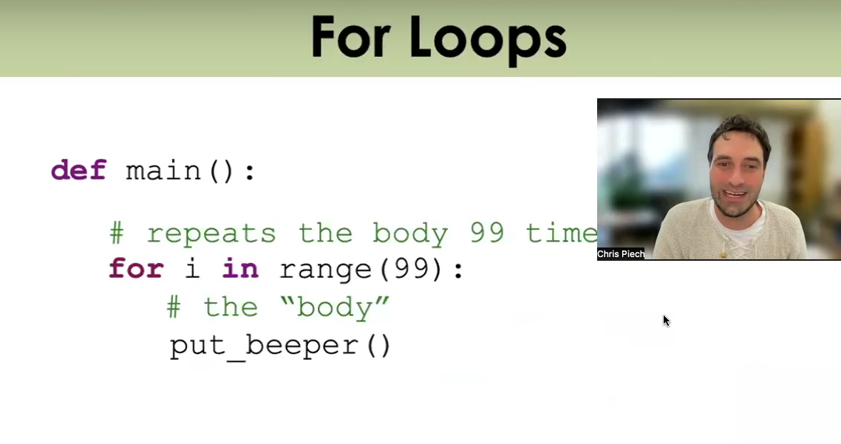
What We’ve Learned
Before we get into our sample problem for today, let’s review a bit. We’ve learned:
The basics about Karel, the magnificent and wonderful robot
Functions, a way of breaking down big problems into smaller chunks
Control Flow, loops and conditional statements which guide our programs
This is a LOT of content, especially if you are newer to Computer Science!

Slide 9
Let’s review and refresh these concepts a bit!

Slide 10
Decomposition: Functions
“Functions should do one thing. They should do it well. They should do it only.” (Robert C Martin, Clean Code)
”
Define your function like this:
def function_name():
<write code here>
And call it like this:
function_name()
Remember:
More of an art than a science.
If you repeat things, take a step back.
def main():
turn_left()
turn_left()
turn_left()
turn_left()
turn_left()
turn_left()
turn_left()
turn_left()
turn_left()
turn_left()
turn_left()
turn_left()
def main():
spin()
spin()
spin()
def spin():
turn_left()
turn_left()
turn_left()
turn_left()
turn_left()
Notes:
Clean Code by Robert C Martin

Slide 11
Control Flow Overview
Let’s look at some of the more difficult conceptual concepts that we’ve learned recently.
For-loop (definite loop):
Performs some block of code, a specific amount of times.
While-loop (indefinite loop):
Continuously perform a block of code until what’s being tested is evaluated to false.
If-statement:
Tests for truth. Performs a block of code only when evaluated to true.

Slide 12
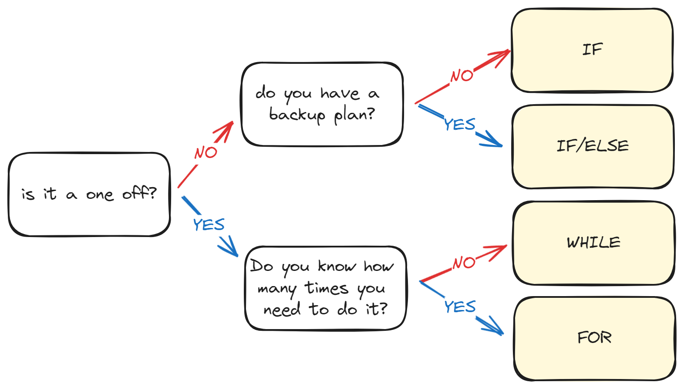
Control Flow Overview

Slide 13
If-Statement
An example if-statement that you may see and use with Karel:
def safe_move():
if front_is_clear():
move()
An if-statement runs code inside of it when the associated statement is evaluated to true. We will get into more complex statements later on in the course to add much more flexibility to our if-statements!

Slide 14
While-Loop
An example while-loop that you may see and use with Karel:
def move_to_wall():
while front_is_clear():
move()
This loop is also called an indefinite loop because it will run until the associated condition becomes false, which may be never! Who knows? You will, hopefully. Be careful so you don’t get stuck in an infinite loop while using this!

Slide 15
For-Loop
An example for-loop that you may see and use with Karel:
def turn_right():
for i in range(3):
turn_left()
This loop is also called a definite loop because we know where it ends, when i reaches 3. (Be careful to remember that i begins at 0 when we start our loop!!!)

Slide 16
Any Questions?

Slide 17
Section Problem: Hospital Karel

Slide 18
Setting Context
Countries around the world are dispatching hospital-building robots to make sure anyone who gets sick can be treated. They have decided to enlist Karel robots. Your job is to program those robots.

Slide 19
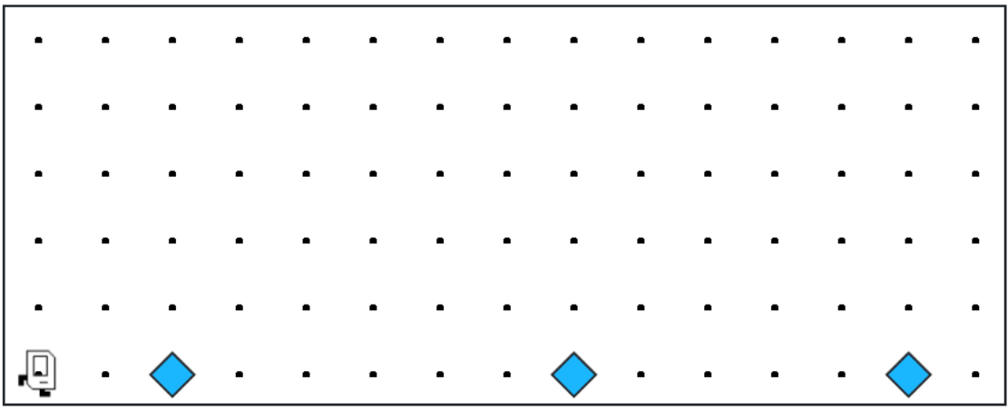
Each beeper in the figure represents a pile of supplies.

Slide 20
Karel’s job is to walk along the row and build a new hospital in the places marked by each beeper.

Slide 21
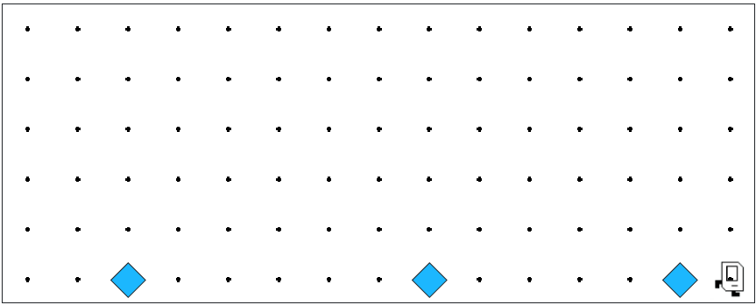

Karel’s job is to walk along the row and build a new hospital in the places marked by each beeper.

Slide 22

Hospitals look like this: a 3x2 rectangle of beepers!

Slide 23
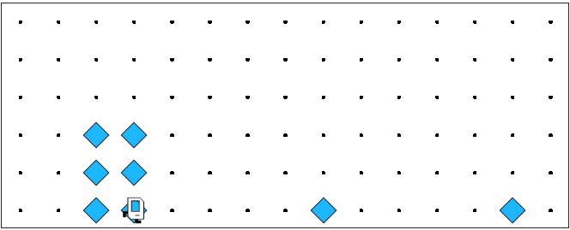
The new hospital should have their corner at the point at which the pile of supplies was left.

Slide 24
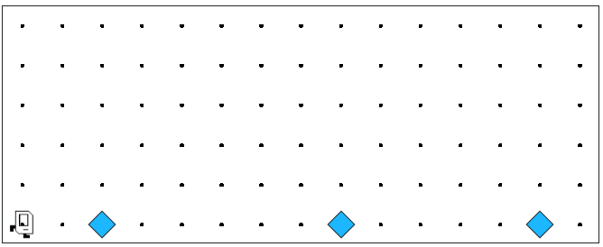
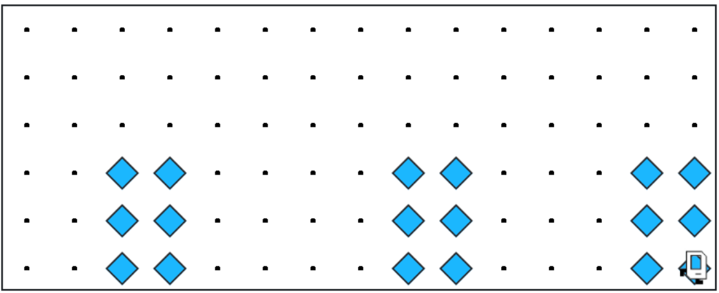
At the end of the run, Karel should be at the end of the row having created a set of hospitals. For the initial conditions shown, the result would look like this:

Slide 25
Notes to Keep in Mind
🗒️
✏️
Karel starts facing east at (1, 1) with an infinite number of beepers in its beeper bag.
The beepers indicating the positions at which hospitals should be built will be spaced so that there is room to build the hospitals without overlapping or hitting walls.
There will be no supplies left on the last column.
Karel should not run into a wall if it builds a hospital that extends into that final corner.

Slide 26
Questions Before We Begin?

Slide 27
Let’s get to work!

